Slide 1
UNITY DISTRIBUTION PORTAL
GAME
INTEGRATION
DOCUMENTATION
Dec 2020

Slide 2
Contents
Game Introduction
File Structure and Scripts
Services of UDP
How I Integrate The Services
Ads
In-App Purchase
Analytics
Cloud Build
Cloud Diagnostics
Collaborate

Slide 3
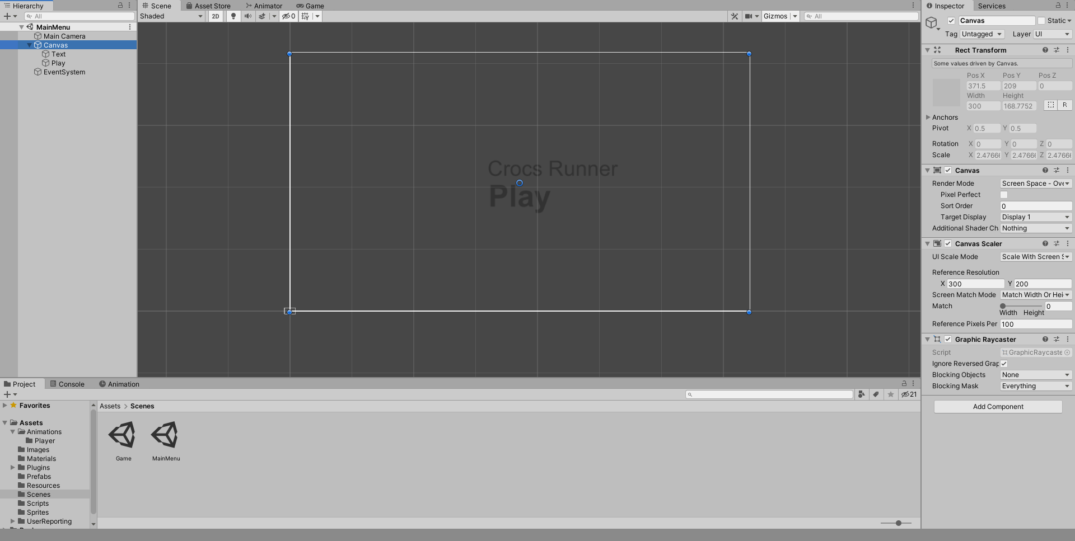
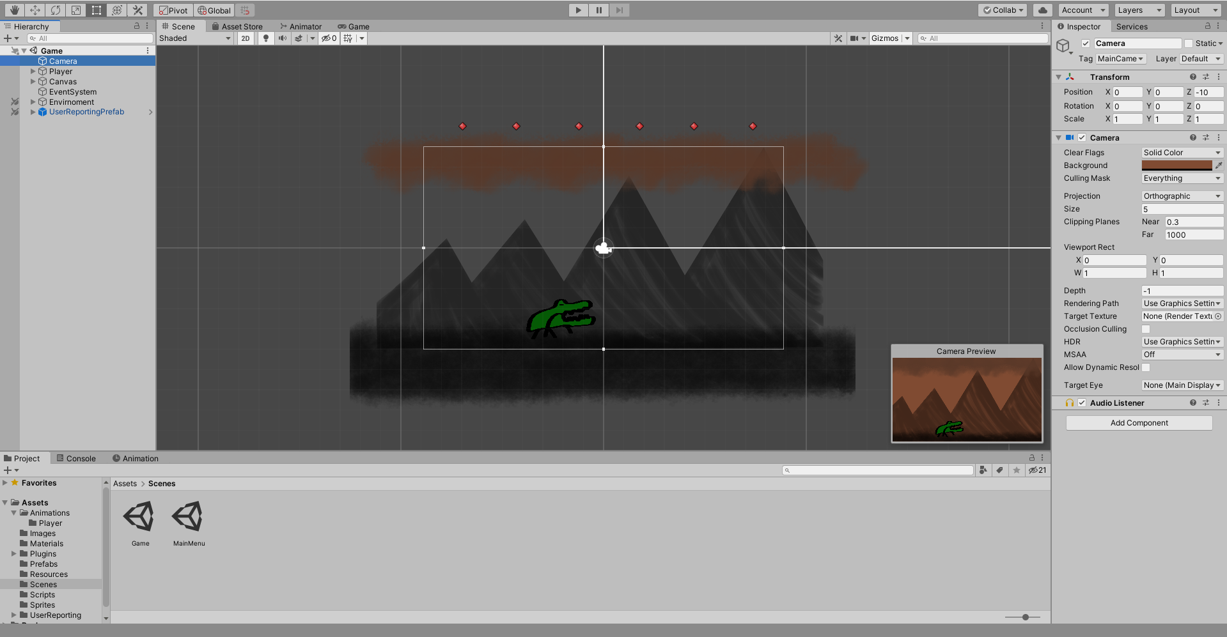
Game Introduction
This demo is for you to understand how Unity Distribution Portal services can be integrated to a project that aims to be launched on Huawei AppGallery.
* Game has 2 Scenes. MainMenu scene is for main menu and Game scene is for playing our game.
When we click to the Play button in this scene, this will take us to the Game scene. There are no more action on this scene so we can just look at the Game scene.
In the GameScene, you can see a background, a player (which is a crocodile) and red dots (we used them as spawners), a health logo and number, and Timer as their score of survival.
Note: Health and Timer are in the Panel (You can see the Canvas Object on the Hierarchy)

Slide 4
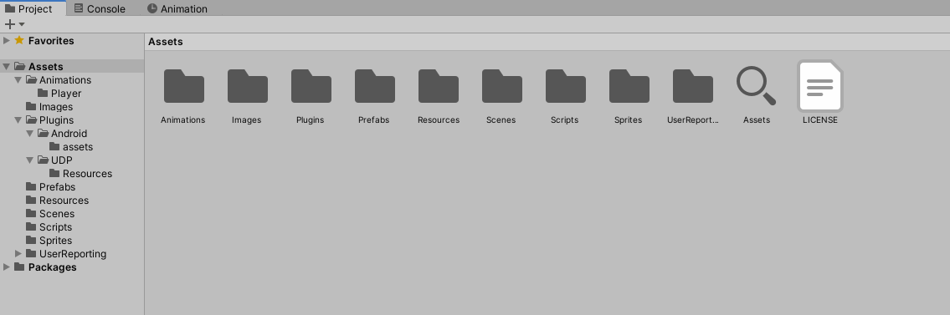
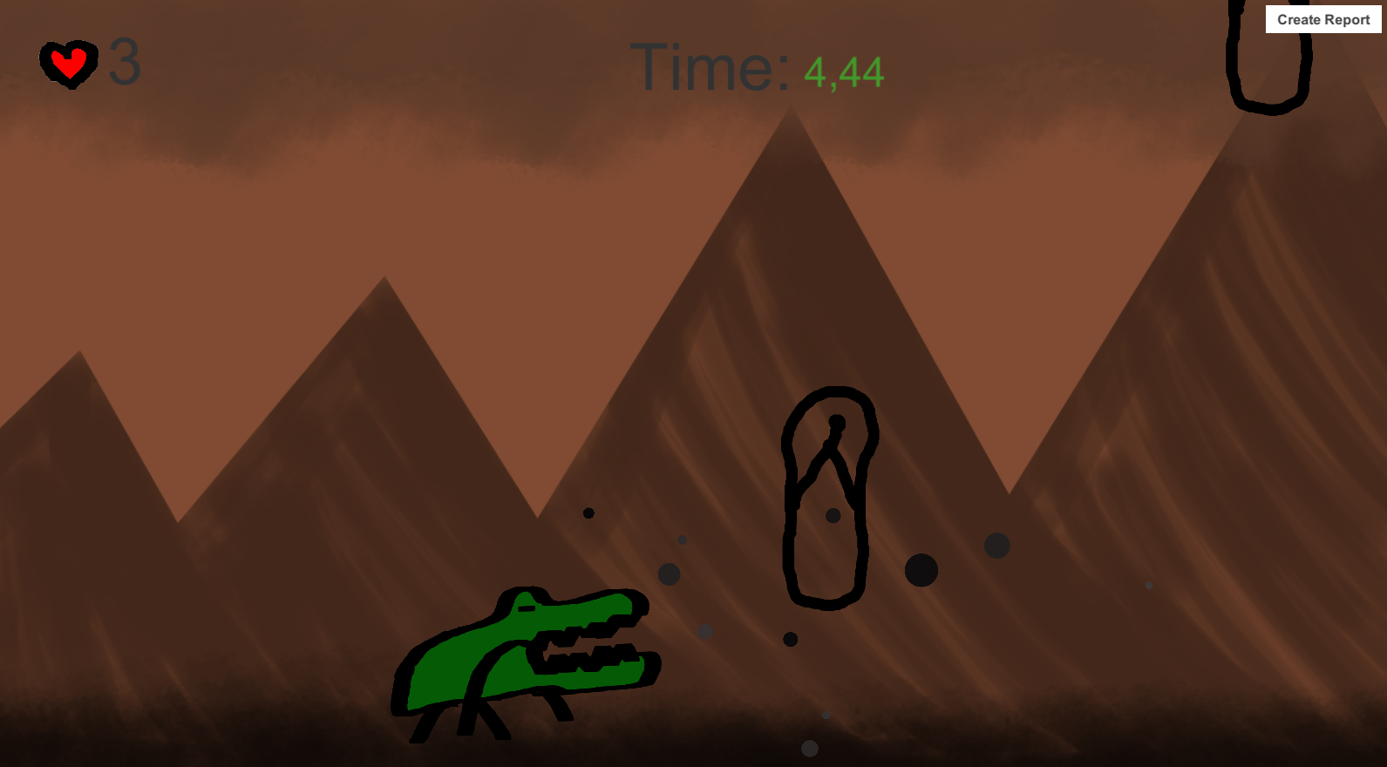
File Structure and Scripts
Demo has several folders such as;
Animations
For storing Players movement animations inside
Images
For storing unstructured image files which we can use them to create sprites
Plugins
This file created by Unity to store UDP and Android configurations in it.
Prefabs
For storing prefab assets of the game
Resources
This file created by Unity to store IAP products catalog
Scenes
For storing scenes such named Game and MainMenu
Scripts
For storing scripts that used for programming
Sprites
For storing sprites files
UserReporting
This file created by Unity to store Cloud Diagnostycs User Report files
Scripts
AdManager: For managing ads
Enemy: Properties about shoes that damages player
GameManager: For managing the game, remove ads and IAP products
Player: Movement animations, movement calculations and sending analytics about player
Spawner: For choosing random spawn point and spawning enemy objects

Slide 5
Services of UDP
Ads
Unity Ads is the ad monetization solution for mobile games from Unity Technologies. It enables mobile game developers to monetize their entire player base, via ads that are native to Unity-based games.
Analytics
Unity Analytics is built for games. It’s natively integrated with Unity, so there’s no SDK to worry about. It gives you specific information you can use to tweak gameplay and offer the best possible experience on multiple platforms. And it helps you get the most out of your monetization efforts.
Cloud Build
Cloud Build makes it simple and easy to create and share builds of your game. It automatically compiles, deploys, and tests your game so you can iterate quickly with your team. Setup takes seconds and works with your existing source control repository.
Cloud Diagnostics
Unity Cloud Diagnostics is a suite of cloud-enabled tools that help you identify, collect, and prioritize feedback. React in real-time to keep your users engaged.
Collaborate
Collaborate features makes it easy for teams to save, share, and sync their Unity projects with others, regardless of location. It’s cloud enabled and built directly into Unity.
In-App Purchasing
Unity IAP (In App Purchases) lets you sell a variety of items directly within your free or paid game including premium content, virtual goods and subscriptions.
Multiplayer
Unity Multiplayer gives us 2 solutions which are Vivox (for multiplayer text and voice) and Multiplay (for hosting solutions) to handle our Multiplayer connections.

Slide 6
How I Integrate The Services

Slide 7
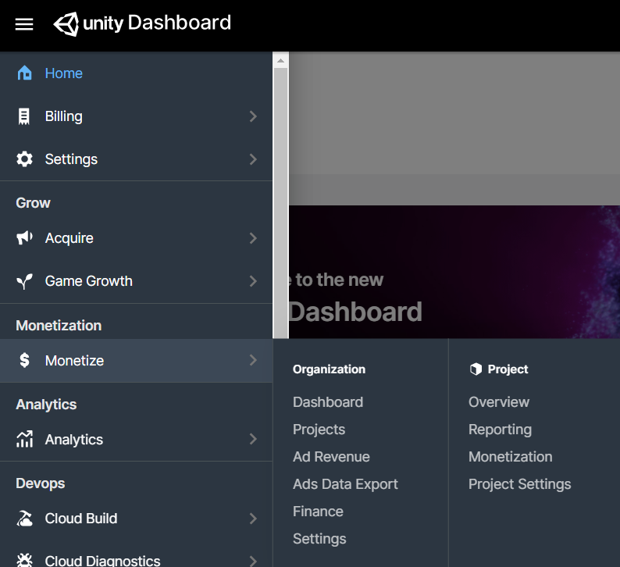
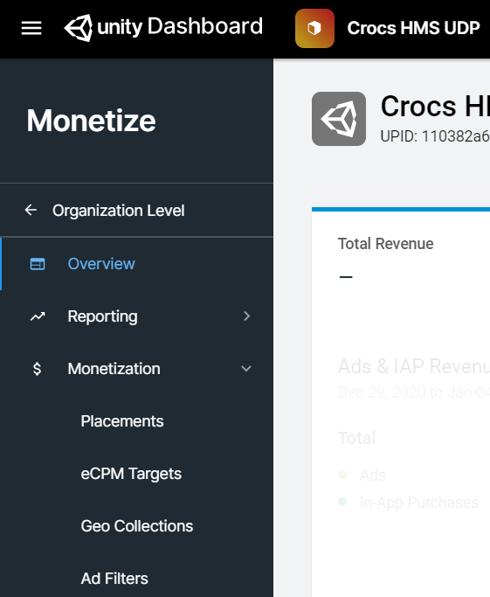
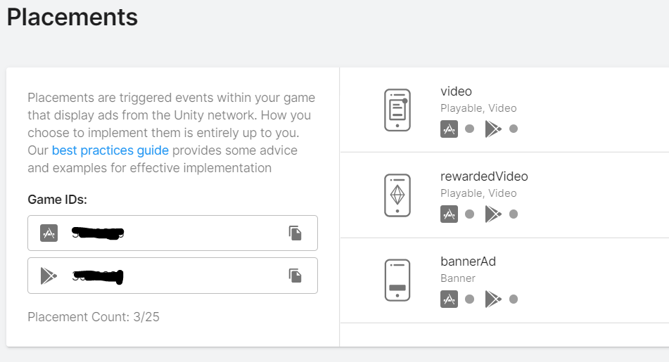
Ads - 1
Before starting to integrate Unity Ads, you can find your Ad IDs about placements down below.
*https://docs.unity3d.com/Manual/UnityAds.html*
Go to https://dashboard.unity3d.com/landing, open the left hand bar and click Projects in Monetize > Projects.
After selecting your project, click Monetization > Placements
You can see your Google Play and IOS game Ids and your advertisement types on the right. You can create more with ‘Add Placement’ button

Slide 8
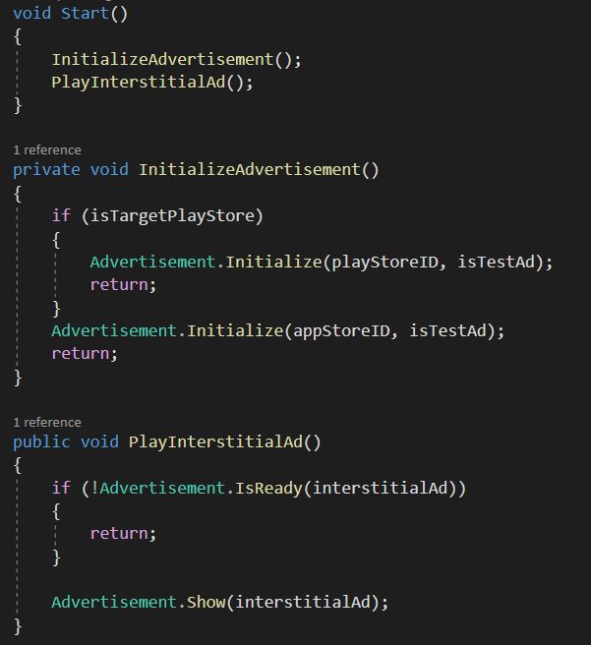
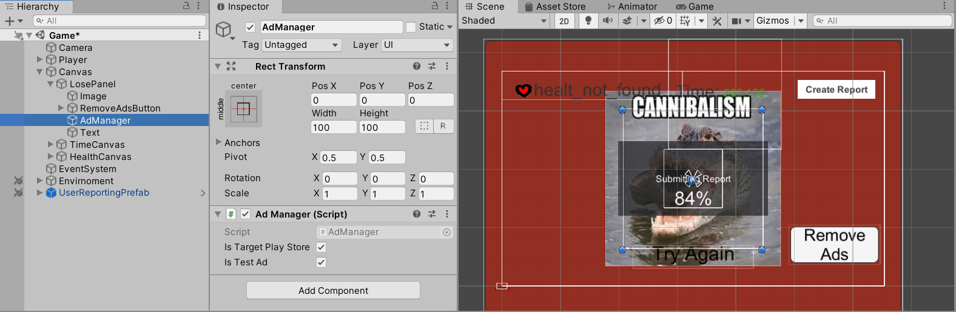
Ads - 2
Normally Parent GameObject ‘LosePanel’ is Disable because of this panel is going to shown when player loses the game. So the AdManager is disabled too as his child gameobject. With that I can initiate the ad showing process after the player dies and it will not shown while the game is going.
Create a new Empty Game Object and create a Script named AdManager wherever your structure does it right.
Open AdManager Script and import UnityEngine.Advertisement and call Advertisement.Initialize(string PlayStoreID, boolean isTestAd).
Than Call Advertisement.show(string AdID) after receiving true from Advertisement.IsReady(string AdID).
After calling the show() method, ad will shown.

Slide 9
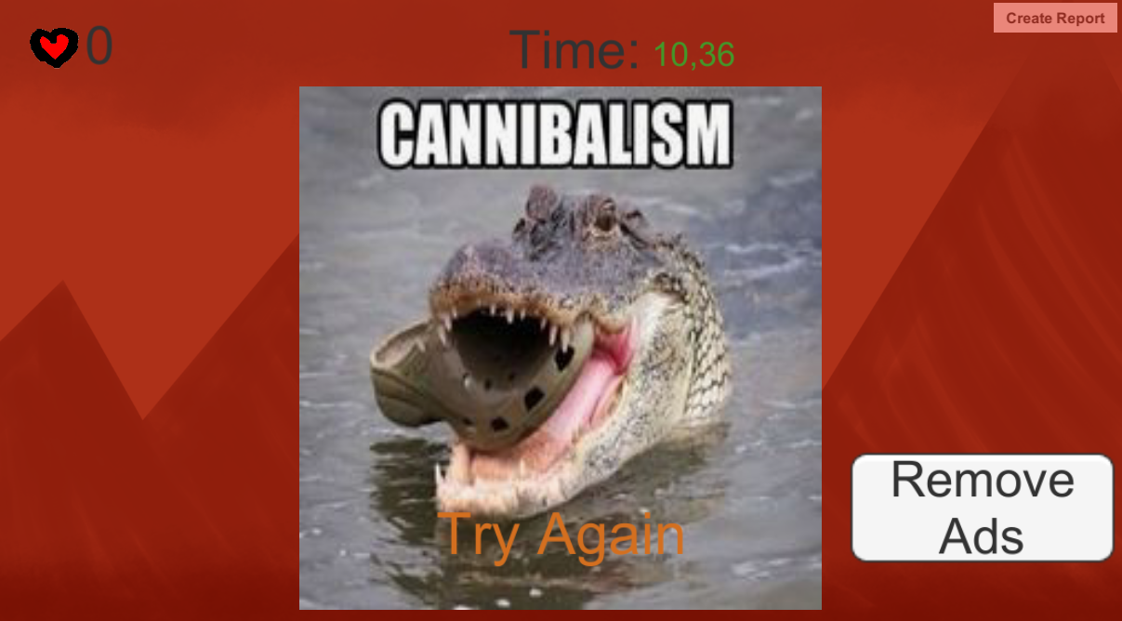
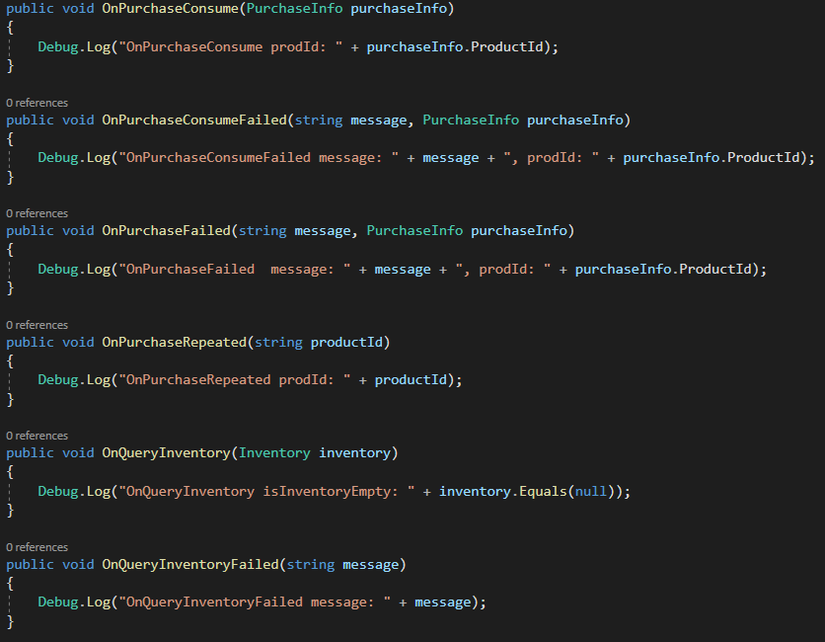
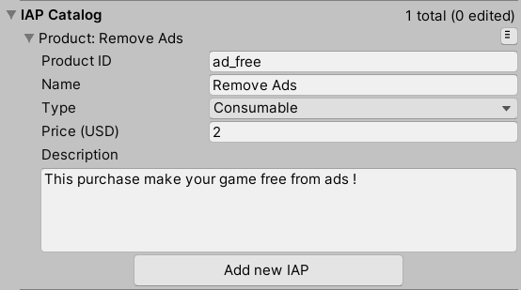
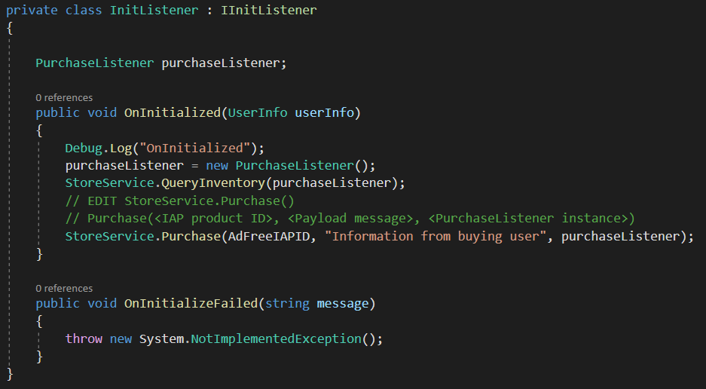
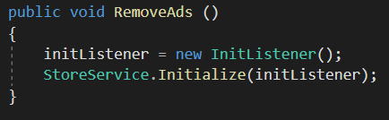
In-App Purchases
Place a button in the scene wherever you want to use as ‘Purchase this’ or ‘Remove Ads’.
Than call the method that you bind. I use RemoveAds().
*https://docs.unity3d.com/Manual/UnityIAP.html*
Go to Assets > Plugins > UDP > Resources > UDP Settings and go to IAP Catalog section to create a IAP product
Import UnityEngine.UDP with ‘using UnityEngine.UDP’ command.
Than create 2 classes to implement ‘IInitListener’ and ‘IPurchaseListener’
Create new Instance of IInitListener and call StoreService.Initialize(IInitListener initListener)
In the OnInitialized method, create a new instance of IPurchaseListener and call StoreService.QueryInventory(IPurchaseListener purchaseListener) than call StoreService.Purchase(string productID, string payload, IPurchaseListener purchaseListener)
Than execute the OnPurchaseX methods to do according to consequences.

Slide 10
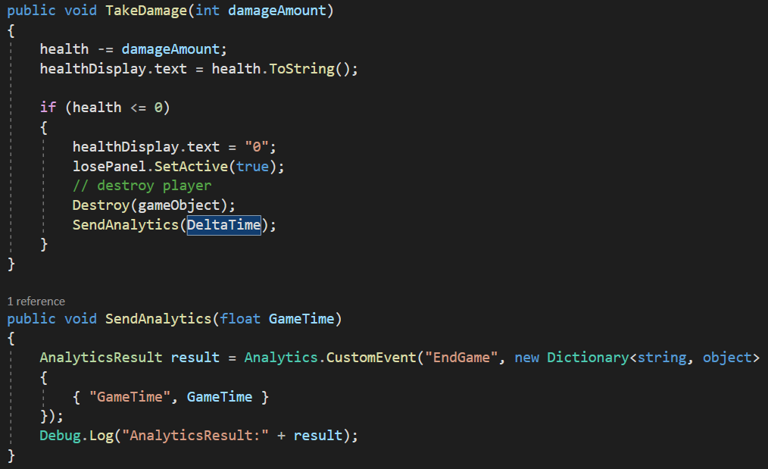
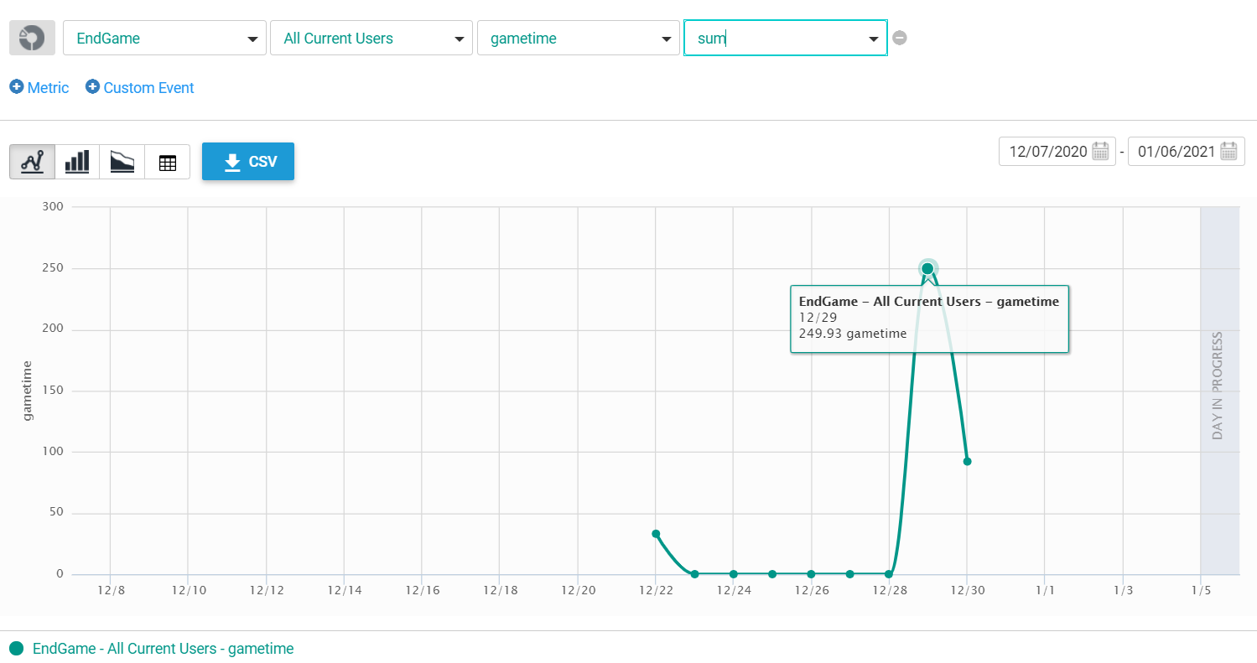
Analytics
Normally just enabling the analytics is enough to collect datas about your game. If you want some specific analytics, than you can use Events.
*https://docs.unity3d.com/Manual/UnityAnalytics.html*
Import UnityEngine.Analytics with ‘using UnityEngine.Analytics’ command
Call Analytics.CustomEvent(‘string’, (optional) Dictionary<string,object> OR Vector3) to send a Custom Event
Create a instance of AnalyticsResult to obtain the result of the analytics transaction
Go to https://analytics.cloud.unity3d.com/ and select the project to see the custom events and other analytics

Slide 11
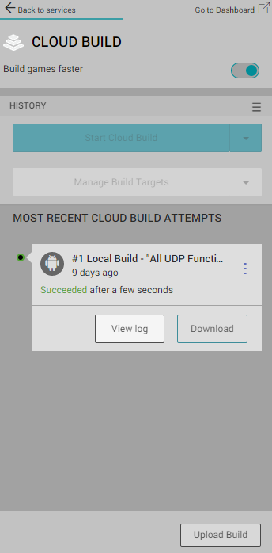
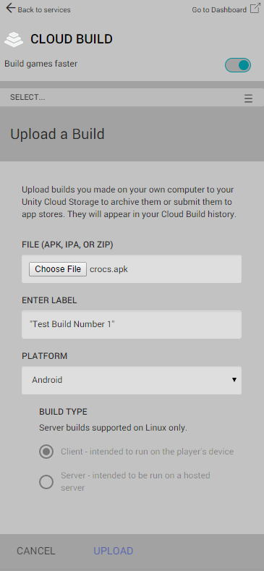
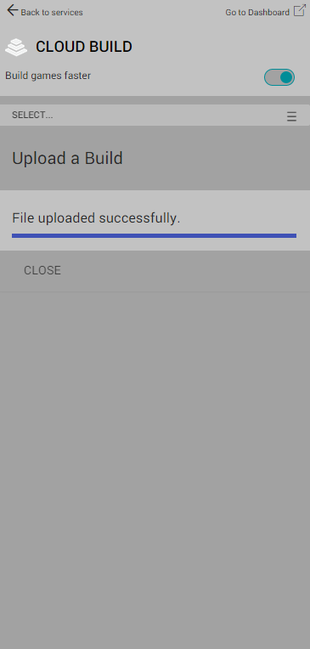
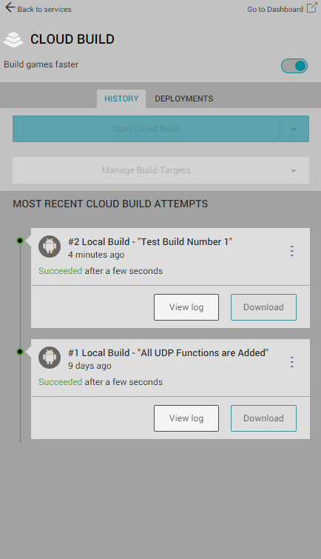
Cloud Build
With Cloud Build, we can build very large project on the cloud and less workforce on developers computers. Additionally you can see logs, details, informations etc. in the dashboard.
*https://docs.unity3d.com/Manual/UnityCloudBuild.html*
After turning on Cloud Build, click ‘Upload’ Build in the bottom
Select the Apk with ‘Choose File’ button, type a label name, choose platform and Click ‘Upload’
After the upload, you can see the Build in the History Section. Click ‘View log’ button to see logs on dasboard web page.

Slide 12
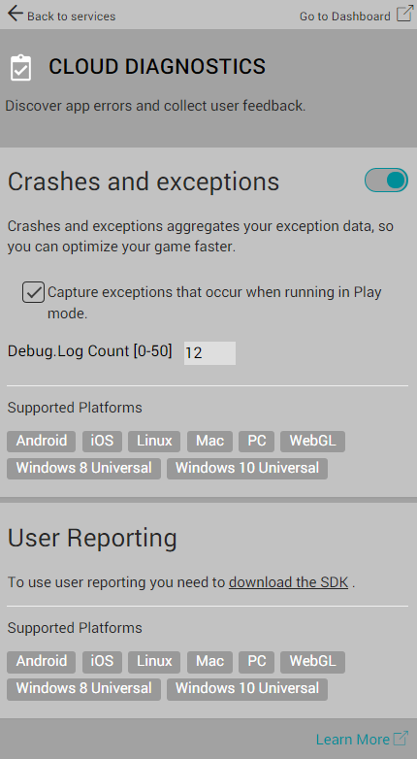
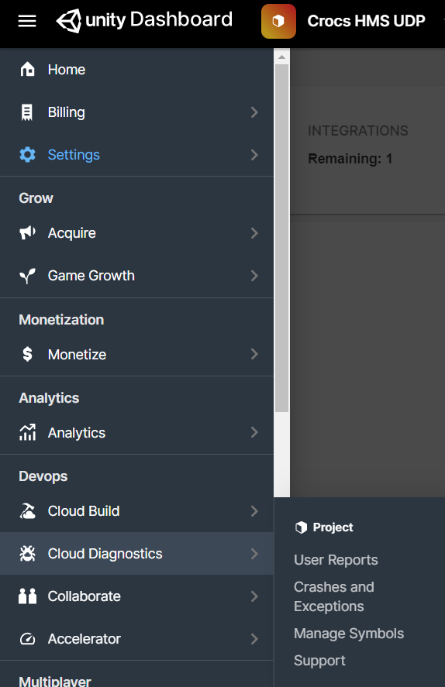
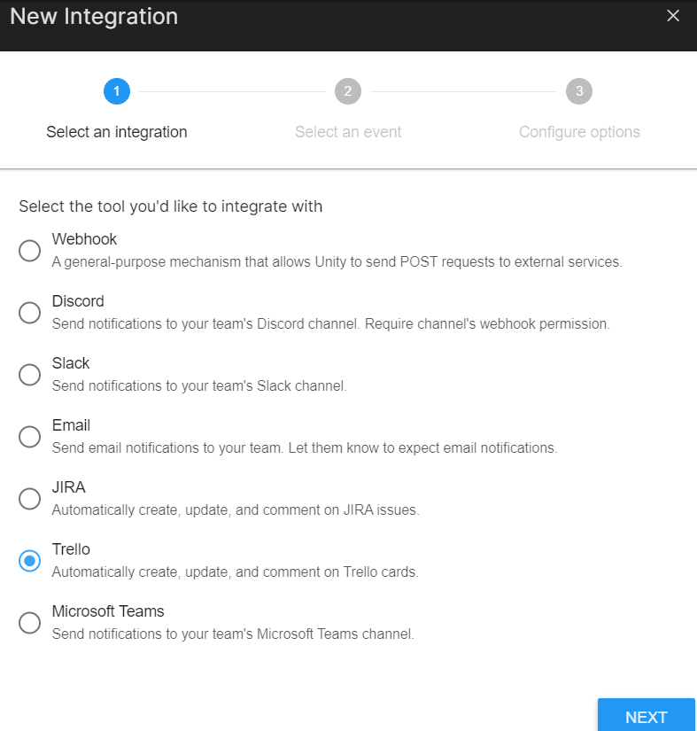
Cloud Diagnostics
Cloud Diagnostics enables us to collect crash and exception informations and user reports to keep our games bug free and user listening.
*https://docs.unity3d.com/Manual/UnityCloudDiagnostics.html*
Enabling the services provides us to collect ‘Debug.Log’s and its enough to use it.
For User reports, you need to click ‘download the SDK’ link in the User Reporting section and add the .unitypackage file to your project
After getting the related files, go to UserReporting > Prefabs and drag the prefab to the our scene where we want users to interact with
Done. If you want to see and use the reports, go to unity dashboard and open Cloud Diagnostics panel. You can even create automated JIRA, Trello etc. İssues and card from them.

Slide 13
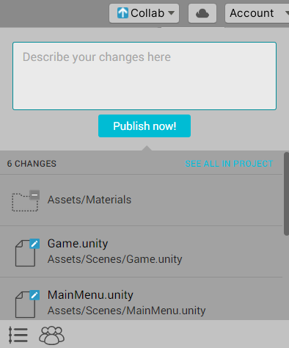
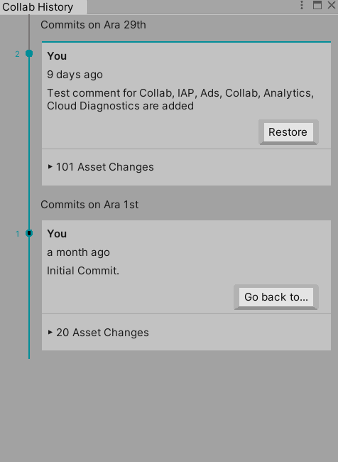
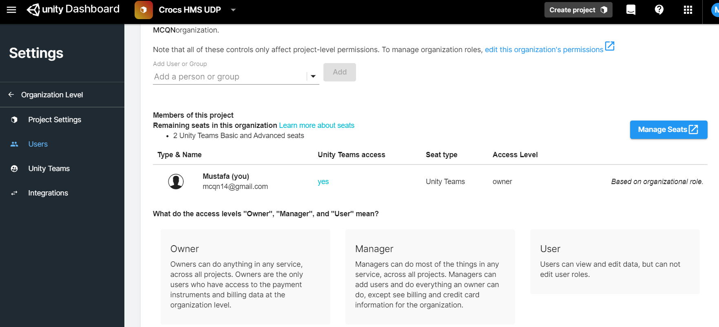
Collaborate
Collaborate is the Version Control system of the Unity to keep tract multiple developers to work on the same project or just for keeping backup versions of projects.
After turning on the service, you need to be logged in to Unity.
*https://docs.unity3d.com/Manual/UnityCloudDiagnostics.html*
Click ‘Collab’ button on the top right than type your changes
Click ‘Publish now!’ button to publish it
You can check the view history or Invite Teammate from bottom left of the collab window
View History
Invite Teammate

Slide 14
THANK YOU

